Slide 1
Countryside High School I.S.T.E.M.
E
T
M
S
Are you interested in a career in
Biotechnology?
Mass Media?
Cyber Security?
Engineering?
If so, then we are the school for you!
@CHS

Slide 2
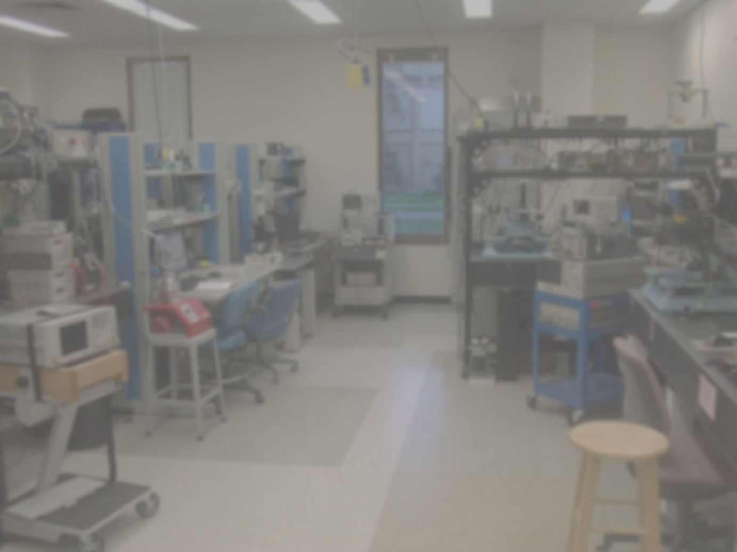
What exactly is STEM?
STEM education grows out of the idea that the boundaries between science, technology, engineering, and math are permeable.
It also asserts that it’s four disciplines are interdependent.
By blending science, technology, engineering, and math, STEM education seeks to create 21st century learning opportunities and skill development for all students.

Slide 3
STEM Education is important to our future!
Employment in fields such as biotechnology, software design, engineering and others is projected to grow 70% faster than growth for other occupations!
STEM graduates, on average, are expected to enjoy better employment prospects and higher earning potential than graduates in non-STEM fields!

Slide 4
The CHS ISTEM (Institute for Science, Technology, Engineering, and Math) program is:
Focused on advanced work in science and math
Based on explorations in the field of engineering
Applied/hands-on research
Supported by partnerships with local business leaders and college representatives.

Slide 5
Our mission:
To offer an accelerated curriculum that develops skills in science, technology, engineering, and mathematics that will provide students with the opportunity for success in college, careers, and life.

Slide 6
ISTEM Admissions Criteria:
Target Group 1-
Students who meet ALL of the following:
-standardized test Total Battery (TB) score at or above 90th percentile
-middle school final grades in science, math and computers of B or higher
-middle school final grades in all other academic courses of B or higher
-a full-credit earned in Algebra I Honors with a C or better by the last day of 8th grade

Slide 7
ISTEM Admissions Criteria:
Target Group 2-
If a student does not meet all of the aforementioned criteria, the Admission Screening Committee will determine if the applicant:
Has the potential and should be placed in Target Group 2, or
Appears to have the potential for the program and needs an individual interview for further screening for Target Group 2, or
Appears to lack the potential for the program and therefore will not receive further screening.

Slide 8
All acceptances are contingent upon successful completion of 8th grade with the final 8th grade report card reflecting entrance requirements for the CSHS ISTEM program.
Should there be a greater number of qualified applicants than available spots in Target Groups 1 and 2, applicants will be selected randomly by computer from each target group of eligible candidates.

Slide 9
9th Graders will take:
English Honors
Algebra II Honors
Geometry Honors
Biology Honors
American Government Honors
Introduction to Information Technology
Introduction to ISTEM
World Language

Slide 10
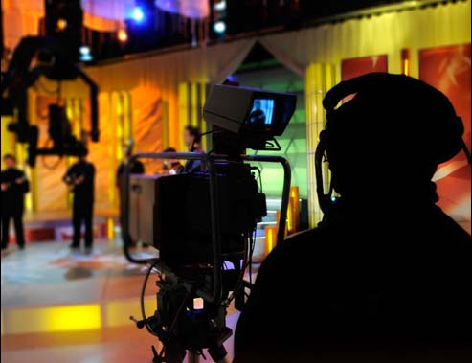
Students will select one of the following four strands as their focus for grades 10-12:
Cyber Security
Engineering
Biotechnology
Mass Media/Television Production

Slide 11
Students will have the opportunity to earn industry certifications in the following areas:
Microsoft Office Specialist
CompTIA A+
CompTIA Security+
CompTIA Network+
Apple FinalCut Pro
Adobe Suite
Biotechnology

Slide 12
Thank you for your interest in Countryside High School ISTEM!
We look forward to serving you and our community by providing educated and certified scholars and workers!

